Slide 1


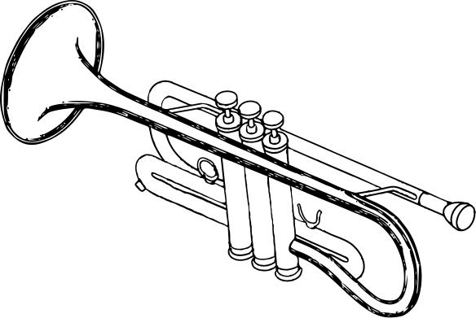
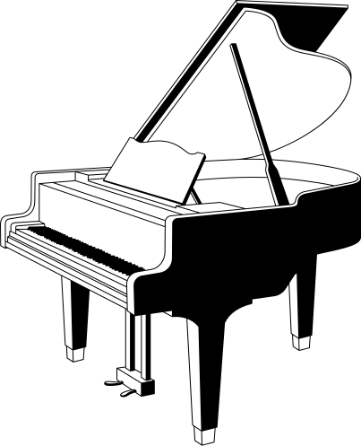
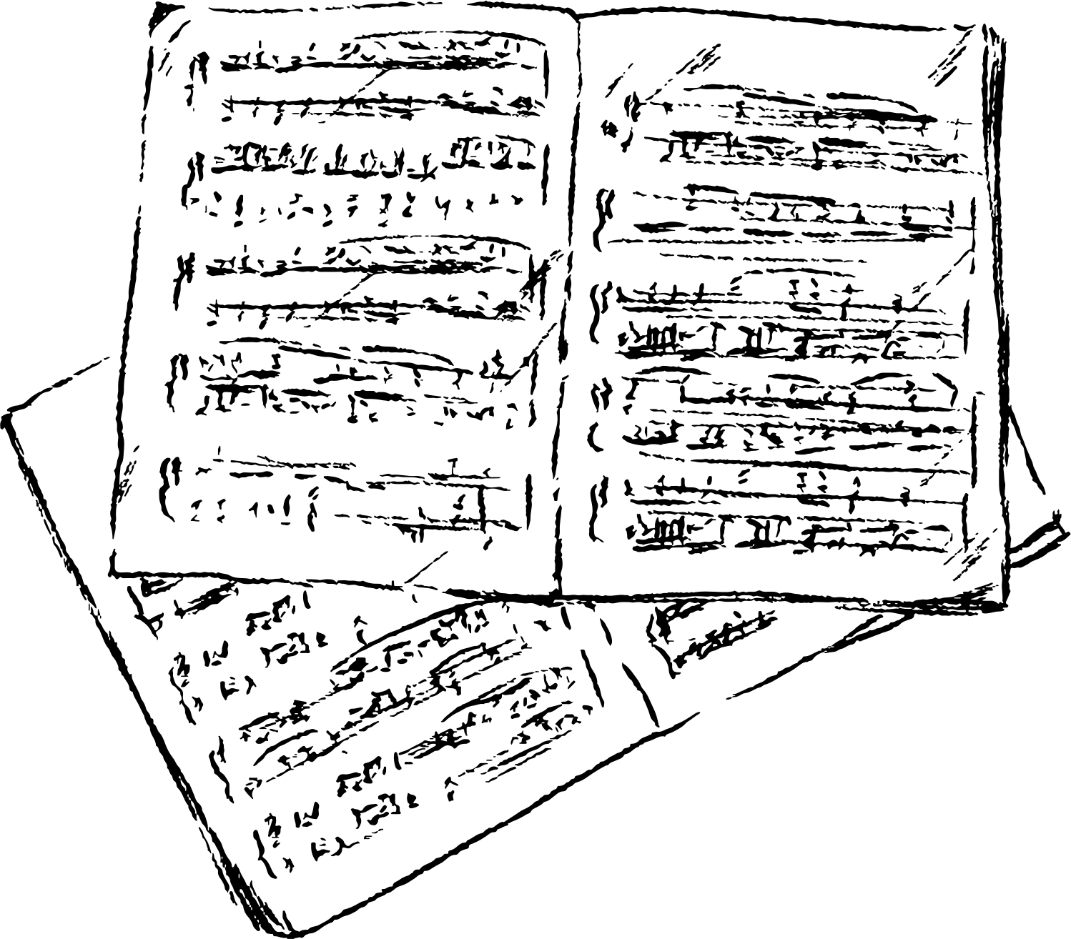
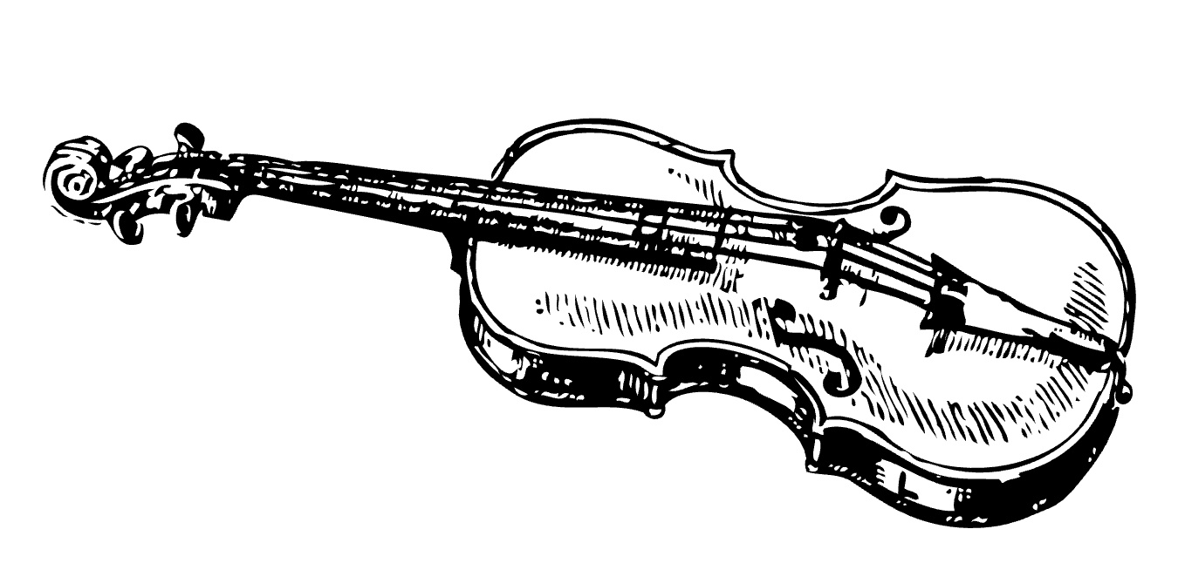
🎵 MUSIC GENRE ORACLE
BY DEEP LERANING 🎵
An Interactive System for Music Genre Prediction
By Fathima Nasrin

Slide 2
CONTENT
Introduction
Dataset and Preprocessing
Audio Signal Representation
Model Architecture
Interactive Gradio Interface
Work Flow
Result
Conclusion
Application

Slide 3

INTRODUCTION
This project focuses on predicting music genres using a deep learning model.
The model analyzes audio features and spectrograms to identify genres with high confidence.
Objective:
To design an accurate and user-friendly system for predicting music genres.

Slide 4
DATASET and PREPROCESSING
Dataset:
10 genres (Blues, Classical, Country, Disco, Hip-hop, Jazz, Metal, Pop, Reggae, Rock).
Each genre includes 30-second audio clips.
Preprocessing Steps:
Load audio files using Librosa.
Convert audio signals to mel spectrograms.
Normalize and reshape data to uniform dimensions (128x128).

Slide 5
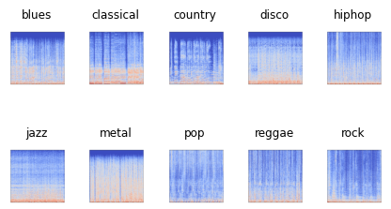
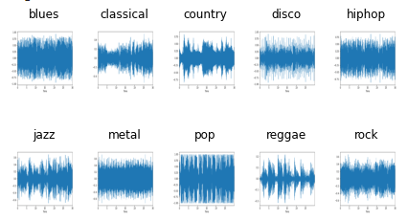
Audio Signal Representation
"Waveforms and spectrograms for different music genres, showcasing distinct audio patterns."
“Waveforms provide insights into amplitude variations over time, while spectrograms highlight frequency and time-based features. These visualizations help the model differentiate between genres."

Slide 6
MODEL ARCHITECTURE
Overview of Model Design
Convolutional Neural Network (CNN).
Layers and Features:
Input: 128x128 mel spectrograms.
Conv Layers: Extract spatial features.
Batch Normalization: Speeds up training.
Dropout: Prevents overfitting.
Dense Layer: Outputs probabilities for each genre.

Slide 7
Workflow
Input Layer
Mel spectroghrams,128x128
Conv Layer
Extract features
Batch Normalization
Speeds up training
Dropout
Dense
Prevents Overfitting
Output probabilities for music genres

Slide 8
INTERACTIVE GRADIO INTERFACE
Tools Used:
Gradio for building the interactive interface.
Features:
Allows users to upload audio files.
Predicts genre with confidence scores.
Provides a user-friendly experience.

Slide 9
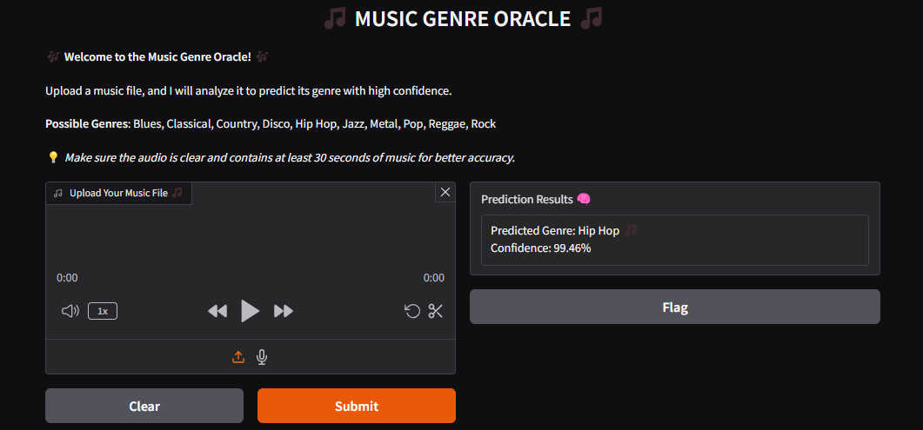
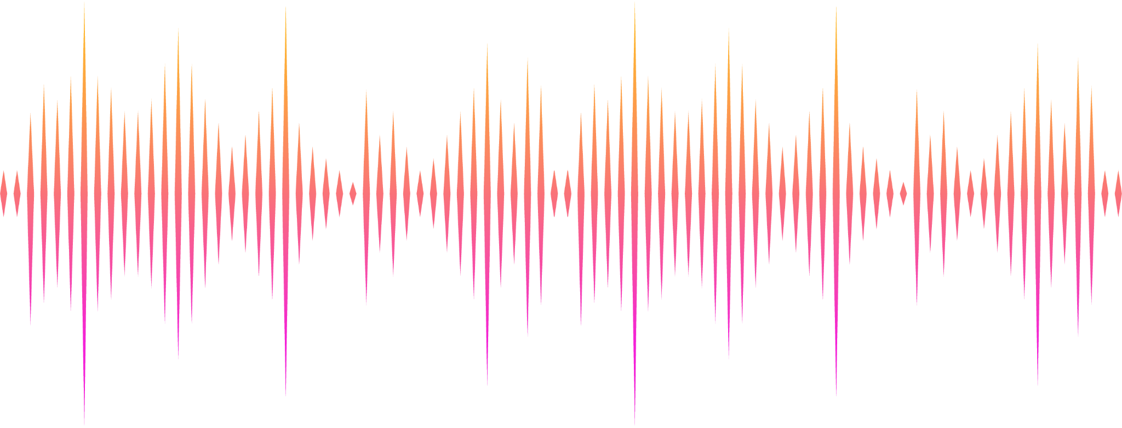
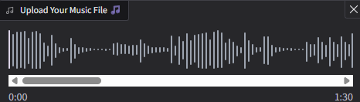
Result
- Input: Hip-Hop audio.
- Output: Predicted Genre: Hip-Hop with 99.46% confidence.

Slide 10
Future Importance
1 . Personalized music experiences:
This project can significantly enhance user experiences in music streaming platforms by enabling better genre-based recommendations.
Real-time music identification can revolutionize live streaming and DJ events.
2 . AI Integration in the Music Industry:
Encourages the use of AI for tasks like music creation, mixing, and production, supporting artists and sound engineers.
Could serve as a foundation for applications such as emotional music tagging, helping users discover music by mood.
3 . Applications in Education and Research:
Enables musicologists to analyze genre trends and compositions.
Useful for teaching music theory by providing examples of genres based on audio features.
4. Advancements in Audio Analysis:
The methodologies in this project (e.g., spectrogram-based CNNs) can inspire broader research in areas like voice recognition, sound classification, and environmental audio detection.

Slide 11
CONCLUSION
Developed a robust model with an interactive interface.
Accurate genre classification for 10 genres.
Encourages innovative uses of AI in the music industry.
Provides a foundation for future advancements in audio analysis.
APPLICATION
Music streaming platforms and audio classification systems.
Enhanced recommendation engines .
Real-time genre detection for DJ systems and live performances.
Educational tools for music theory.

Slide 12
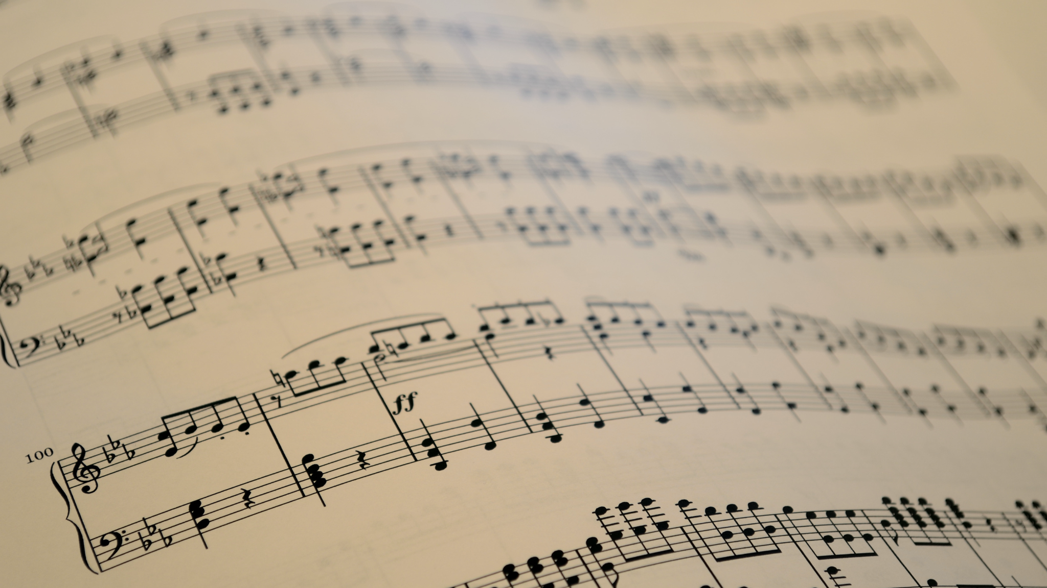
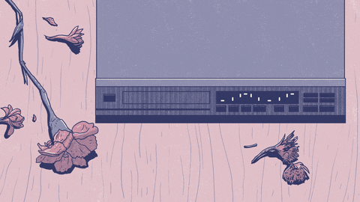
Thank you for your time and attention!

